Slide 1
UNIT – III
DYNAMIC PROGRAMMING

Slide 2
Introduction
Dynamic programming is a technique for solving problems with overlapping sub-problems.
Typically, these sub-problems arise from a recurrence relating a solution to a given problem with solutions to its smaller sub-problems of the same type.

Slide 3
Introduction
Rather than solving overlapping sub-problems again and again,
dynamic programming suggests solving each of the smaller sub-problems only once
and recording the results in a table from which we can then obtain a solution to the original problem.

Slide 4
Dynamic Programming
Dynamic Programming is a general algorithm design technique
for solving problems defined by or formulated as recurrences with overlapping subinstances
Invented by American mathematician Richard Bellman in the 1950s to solve optimization problems
“Programming” here means “planning”
Main idea:
    set up a recurrence relating a solution to a larger instance to solutions of some smaller instances
    - solve smaller instances once
    record solutions in a table
    extract solution to the initial instance from that table

Slide 5
Example: Fibonacci numbers
Recall definition of Fibonacci numbers:
  F(n) = F(n-1) + F(n-2)
  F(0) = 0
  F(1) = 1
Computing the n^{th} Fibonacci number recursively (top-down):
F(n)
F(n-1) + F(n-2)
F(n-2) + F(n-3) F(n-3) + F(n-4)
...

Slide 6
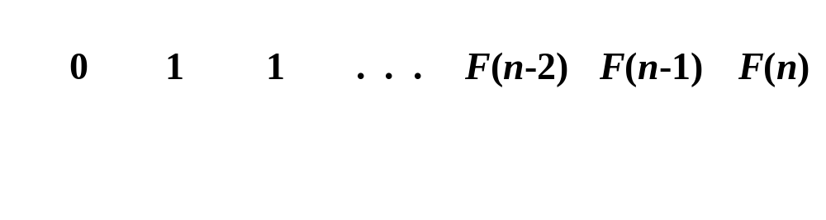
Example: Fibonacci numbers (cont.)
  Computing the n^{th} Fibonacci number using bottom-up iteration and recording results:
F(0) = 0
F(1) = 1
F(2) = 1+0 = 1
…
F(n-2) =
F(n-1) =
F(n) = F(n-1) + F(n-2)
Efficiency:
- time
- space
What if we solve it recursively?
n
n

Slide 7
Introduction
The Fibonacci numbers are the elements of the sequence
0, 1, 1, 2, 3, 5, 8, 13, 21, 34, . . . ,
Algorithm fib(n)
if n = 0 or n = 1 return 1
return fib(n − 1) + fib(n − 2)
The original problem F(n) is defined by F(n-1) and F(n-2)

Slide 8
Introduction
Notice that if we call, say, fib(5), we produce a call tree that calls the function on the same value many different times:
fib(5)
fib(4) + fib(3)
(fib(3) + fib(2)) + (fib(2) + fib(1))
((fib(2) + fib(1)) + (fib(1) + fib(0))) + ((fib(1) + fib(0)) + fib(1))
(((fib(1) + fib(0)) + fib(1)) + (fib(1) + fib(0))) + ((fib(1) + fib(0)) + fib(1))
If we try to use recurrence directly to compute the n^{th} Fibonacci number F(n) , we would have to recompute the same values of this function many times

Slide 9
Introduction
Certain algorithms compute the n^{th} Fibonacci number without computing all the preceding elements of this sequence.
It is typical of an algorithm based on the classic bottom-up dynamic programming approach,
A top-down variation of it exploits so-called memory functions
The crucial step in designing such an algorithm remains the same => Deriving a recurrence relating a solution to the problem’s instance with solutions of its smaller (and overlapping) subinstances.

Slide 10
Introduction
Dynamic programming usually takes one of two approaches:
Bottom-up approach: All subproblems that might be needed are solved in advance and then used to build up solutions to larger problems. This approach is slightly better in stack space and number of function calls, but it is sometimes not intuitive to figure out all the subproblems needed for solving the given problem.
Top-down approach: The problem is broken into subproblems, and these subproblems are solved and the solutions remembered, in case they need to be solved again. This is recursion and Memory Function combined together.

Slide 11
Bottom Up
In the bottom-up approach we calculate the smaller values of Fibo first, then build larger values from them. This method also uses linear (O(n)) time since it contains a loop that repeats n − 1 times.
In both these examples, we only calculate fib(2) one time, and then use it to calculate both fib(4) and fib(3), instead of computing it every time either of them is evaluated.
Algorithm Fibo(n)
a = 0, b = 1
repeat n − 1 times
c = a + b
a = b
b = c
return b

Slide 12
Top-Down
suppose we have a simple map object, m, which maps each value of Fibo that has already been calculated to its result, and we modify our function to use it and update it. The resulting function requires only O(n) time instead of exponential time:
This technique of saving values that have already been calculated is called Memory Function; this is the top-down approach, since we first break the problem into subproblems and then calculate and store values
m [0] = 0
m [1] = 1
Algorithm Fibo(n)
if map m does not contain key n
m[n] := Fibo(n − 1) + Fibo(n − 2)
return m[n]

Slide 13
Examples of DP algorithms
Computing a binomial coefficient
Longest common subsequence
Warshall’s algorithm for transitive closure
Floyd’s algorithm for all-pairs shortest paths
Constructing an optimal binary search tree
Some instances of difficult discrete optimization problems:
  - traveling salesman
  - knapsack

Slide 14
Computing a binomial coefficient by DP
  Binomial coefficients are coefficients of the binomial formula:
  (a + b)^{n} = C(n,0)a^{n}b⁰ + . . . + C(n,k)a^{n-k}b^{k} + . . . + C(n,n)a⁰b^{n}
  Recurrence: C(n,k) = C(n-1,k) + C(n-1,k-1) for n > k > 0
  C(n,0) = 1, C(n,n) = 1 for n ≥ 0
  Value of C(n,k) can be computed by filling a table:
  0 1 2 . . . k-1 k
  0 1
  1 1 1
  .
  .
  .
  n-1 C(n-1,k-1) C(n-1,k)
  n C(n,k)

Slide 15
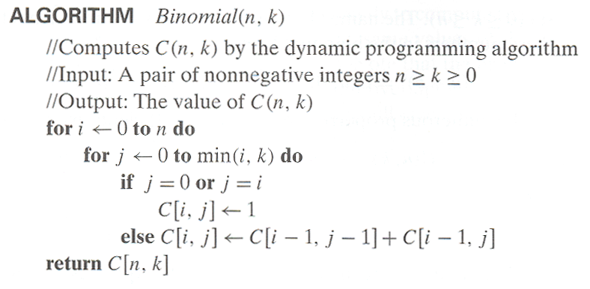
Computing C(n,k): pseudocode and analysis
Time efficiency: Θ(nk)
Space efficiency: Θ(nk)

Slide 16
Warshall’s Algorithm: Transitive Closure
Computes the transitive closure of a relation
Alternatively: existence of all nontrivial paths in a digraph
Example of transitive closure:
3
3
1
1
4
4
0 0 1 0
1 1 1 1
0 0 0 0
1 1 1 1
2
0 0 1 0
1 0 0 1
0 0 0 0
0 1 0 0
2

Slide 17
Warshall’s Algorithm
Constructs transitive closure T as the last matrix in the sequence of n-by-n matrices R⁽⁰⁾, … , R^{(k)}, … , R^{(n)} where
R^{(k)}[i,j] = 1 iff there is nontrivial path from i to j with only the first k vertices allowed as intermediate
Note that R⁽⁰⁾ = A (adjacency matrix), R^{(n)} = T (transitive closure)
3
3
3
3
3
1
1
1
1
1
4
4
4
2
4
4
2
2
2
2
R⁽⁰⁾
0 0 1 0
1 0 0 1
0 0 0 0
0 1 0 0
R⁽¹⁾
0 0 1 0
1 0 1 1
0 0 0 0
0 1 0 0
R⁽²⁾
0 0 1 0
1 0 1 1
0 0 0 0
1 1 1 1
R⁽³⁾
0 0 1 0
1 0 1 1
0 0 0 0
1 1 1 1
R⁽⁴⁾
0 0 1 0
1 1 1 1
0 0 0 0
1 1 1 1

Slide 18
Warshall’s Algorithm (recurrence)
On the k-th iteration, the algorithm determines for every pair of vertices i, j if a path exists from i and j with just vertices 1,…,k allowed as intermediate
        R^{(k-1)}[i,j] (path using just 1 ,…,k-1)
R^{(k)}[i,j] = or
      R^{(k-1)}[i,k] and R^{(k-1)}[k,j] (path from i to k
      and from k to j
      using just 1 ,…,k-1)
{
k
i
Initial condition?
j

Slide 19
Warshall’s Algorithm (matrix generation)
Recurrence relating elements R^{(k)} to elements of R^{(k-1)} is:
      R^{(k)}[i,j] = R^{(k-1)}[i,j] or (R^{(k-1)}[i,k] and R^{(k-1)}[k,j])
It implies the following rules for generating R^{(k)} from R^{(k-1)}:
Rule 1 If an element in row i and column j is 1 in R^{(k-1)},
it remains 1 in R^{(k)}
Rule 2 If an element in row i and column j is 0 in R^{(k-1)},
it has to be changed to 1 in R^{(k)} if and only if
the element in its row i and column k and the element
in its column j and row k are both 1’s in R^{(k-1)}

Slide 20
Warshall’s Algorithm (example)
3
0 0 1 0
1 0 0 1
0 0 0 0
0 1 0 0
0 0 1 0
1 0 1 1
0 0 0 0
0 1 0 0
1
R⁽⁰⁾ ⁼
R⁽¹⁾ ⁼
2
4
0 0 1 0
1 0 1 1
0 0 0 0
1 1 1 1
0 0 1 0
1 0 1 1
0 0 0 0
1 1 1 1
0 0 1 0
1 1 1 1
0 0 0 0
1 1 1 1
R⁽²⁾ ⁼
R⁽³⁾ ⁼
R⁽⁴⁾ ⁼

Slide 21
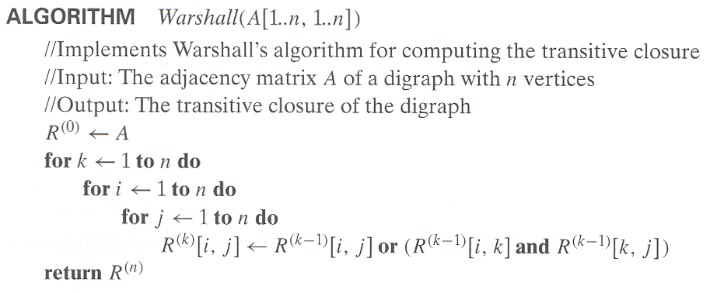
Warshall’s Algorithm (pseudocode and analysis)
Time efficiency: Θ(n³)
Space efficiency: Matrices can be written over their predecessors
(with some care), so it’s Θ(n^2).

Slide 22
Floyd’s Algorithm: All pairs shortest paths
Problem: In a weighted (di)graph, find shortest paths between
every pair of vertices
Same idea: construct solution through series of matrices D⁽⁰⁾, …,
D ^{(n)} using increasing subsets of the vertices allowed
as intermediate
Example:
4
3
1
0 ∞ 4 ∞
1 0 4 3 ∞ ∞ 0 ∞
6 5 1 0
1
6
1
5
4
2
3

Slide 23
Floyd’s Algorithm (matrix generation)
On the k-th iteration, the algorithm determines shortest paths between every pair of vertices i, j that use only vertices among 1,…,k as intermediate
D^{(k)}[i,j] = min {D^{(k-1)}[i,j], D^{(k-1)}[i,k] + D^{(k-1)}[k,j]}
D^{(k-1)}[i,k]
k
i
D^{(k-1)}[k,j]
D^{(k-1)}[i,j]
Initial condition?
j

Slide 24
Floyd’s Algorithm (example)
2
1
2
0 ∞ 3 ∞ 2 0 ∞ ∞
∞ 7 0 1
6 ∞ ∞ 0
0 ∞ 3 ∞
2 0 5 ∞
∞ 7 0 1
6 ∞ 9 0
3
6
7
D⁽⁰⁾ ⁼
D⁽¹⁾ ⁼
3
1
4
0 ∞ 3 ∞
2 0 5 ∞
9 7 0 1
6 ∞ 9 0
0 10 3 4
2 0 5 6
9 7 0 1
6 16 9 0
0 10 3 4
2 0 5 6
7 7 0 1
6 16 9 0
D⁽²⁾ ⁼
D⁽³⁾ ⁼
D⁽⁴⁾ ⁼

Slide 25
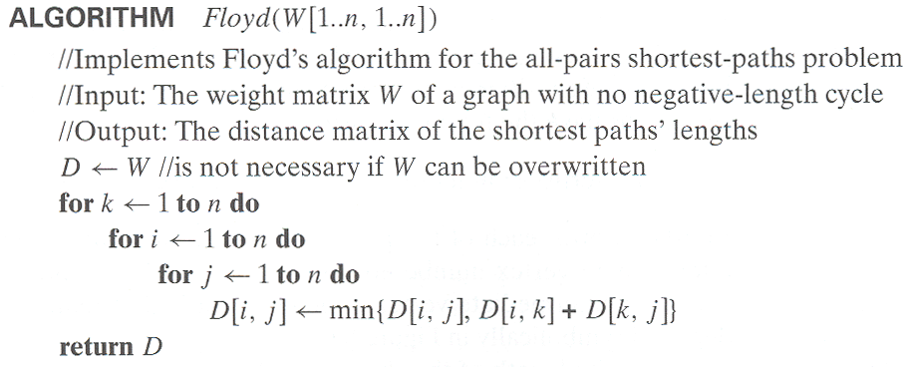
Floyd’s Algorithm (pseudocode and analysis)
If D[i,k] + D[k,j] < D[i,j] then P[i,j] ← k
Since the superscripts k or k-1 make no difference to D[i,k] and D[k,j].
Time efficiency: Θ(n³)
Space efficiency: Matrices can be written over their predecessors
Note: Works on graphs with negative edges but without negative cycles. Shortest paths themselves can be found, too. How?

Slide 26
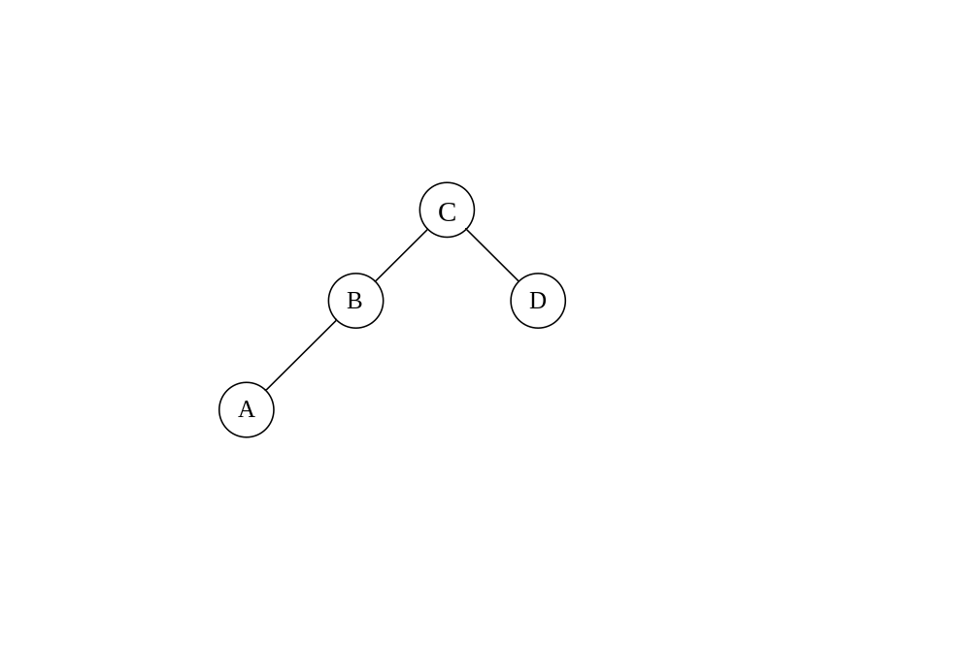
Optimal Binary Search Trees
Problem: Given n keys a₁ < …< a_{n} and probabilities p₁, …, p_{n}
searching for them, find a BST with a minimum
average number of comparisons in successful search.
Since total number of BSTs with n nodes is given by C(2n,n)/(n+1), which grows exponentially, brute force is hopeless.
Example: What is an optimal BST for keys A, B, C, and D with
search probabilities 0.1, 0.2, 0.4, and 0.3, respectively?
Average # of comparisons = 1*0.4 + 2*(0.2+0.3) + 3*0.1 = 1.7

Slide 27
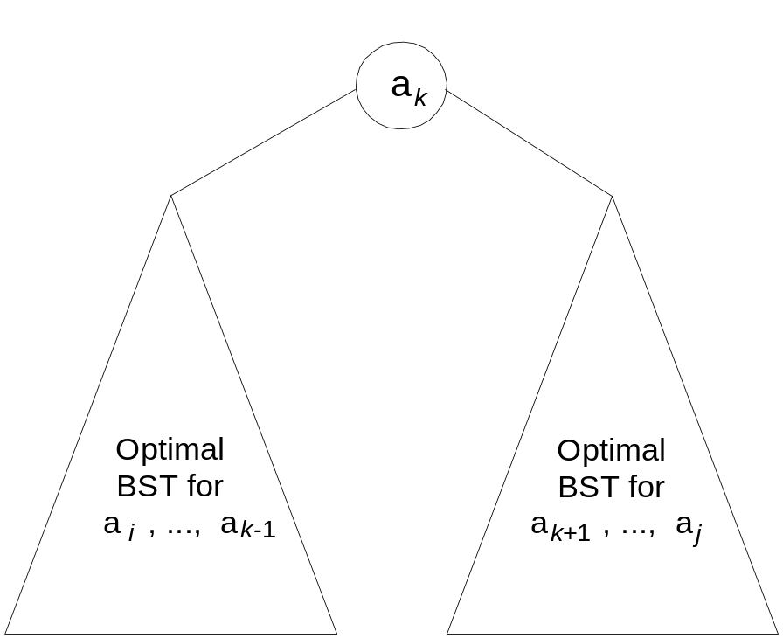
DP for Optimal BST Problem
Let C[i,j] be minimum average number of comparisons made in T[i,j], optimal BST for keys a_{i} < …< a_{j} , where 1 ≤ i ≤ j ≤ n. Consider optimal BST among all BSTs with some a_{k} (i ≤ k ≤ j ) as their root; T[i,j] is the best among them.
C[i,j] =
min {p_{k} · 1 +
∑ p_{s} (level a_{s} in T[i,k-1] +1) +
∑ p_{s} (level a_{s} in T[k+1,j] +1)}
i ≤ k ≤ j
k-1
s = i
j
s =k+1

Slide 28
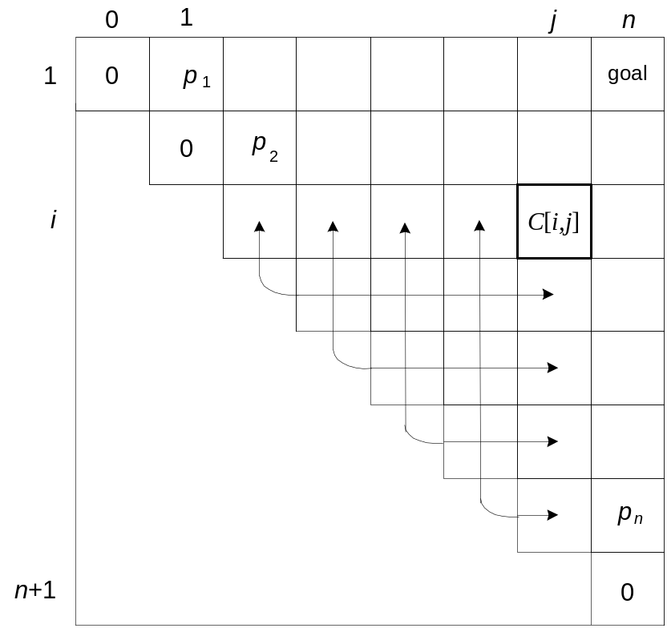
DP for Optimal BST Problem (cont.)
After simplifications, we obtain the recurrence for C[i,j]:
C[i,j] = min {C[i,k-1] + C[k+1,j]} + ∑ p_{s} for 1 ≤ i ≤ j ≤ n
C[i,i] = p_{i} for 1 ≤ i ≤ j ≤ n
j
i ≤ k ≤ j
s = i

Slide 29
Example: key A B C D
probability 0.1 0.2 0.4 0.3
The tables below are filled diagonal by diagonal: the left one is filled using the recurrence
C[i,j] = min {C[i,k-1] + C[k+1,j]} + ∑ p_{s ,} C[i,i] = p_{i} ;
the right one, for trees’ roots, records k’s values giving the minima
j
i ≤ k ≤ j
s = i
_{i} ^{j}
 | 0 | 1 | 2 | 3 | 4
1 | 0 | .1 | .4 | 1.1 | 1.7
2 |  | 0 | .2 | .8 | 1.4
3 |  |  | 0 | .4 | 1.0
4 |  |  |  | 0 | .3
5 |  |  |  |  | 0
_{i} ^{j}
 | 0 | 1 | 2 | 3 | 4
1 |  | 1 | 2 | 3 | 3
2 |  |  | 2 | 3 | 3
3 |  |  |  | 3 | 3
4 |  |  |  |  | 4
5
C
B
D
A
optimal BST

Slide 30
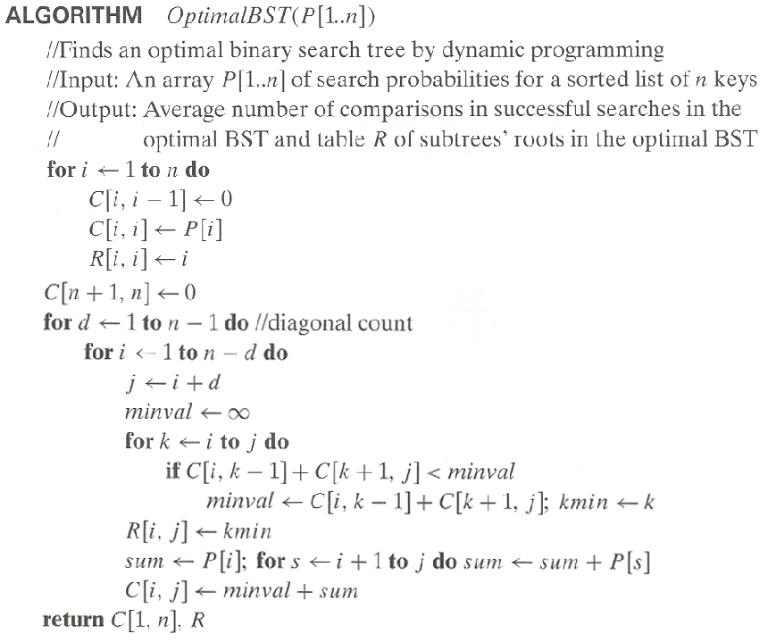
Optimal Binary Search Trees

Slide 31
Analysis DP for Optimal BST Problem
Time efficiency: Θ(n³) but can be reduced to Θ(n²) by taking
advantage of monotonicity of entries in the
root table, i.e., R[i,j] is always in the range
between R[i,j-1] and R[i+1,j]
Space efficiency: Θ(n²)
Method can be expanded to include unsuccessful searches

Slide 32
Knapsack Problem by DP
Given n items of
  integer weights: w₁ w₂ … w_{n}
  values: v₁ v₂ … v_{n}
a knapsack of integer capacity W
find most valuable subset of the items that fit into the knapsack
Consider instance defined by first i items and capacity j (j ≤ W).
Let V[i,j] be optimal value of such an instance. Then
max {V[i-1,j], v_{i} + V[i-1,j- w_{i}]} if j- w_{i} ≥ 0
V[i,j] =
V[i-1,j] if j- w_{i} < 0
Initial conditions: V[0,j] = 0 and V[i,0] = 0
{

Slide 33
Knapsack Problem by DP (example)
Example: Knapsack of capacity W = 5
item weight value
1 2 $12
2 1 $10
3 3 $20
4 2 $15 capacity j
0 1 2 3 4 5
0
w₁ = 2, v₁= 12 1
w₂ = 1, v₂= 10 2
w₃ = 3, v₃= 20 3
w₄ = 2, v₄= 15 4 ?
0 0 0
0 0 12
0 10 12
22 22 22
0 10 12 22 30 32
0 10 15 25 30 37
Backtracing finds the actual optimal subset, i.e. solution.

Slide 34
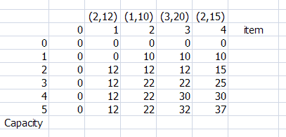
Example – Dynamic Programming Table
capacity W = 5

Slide 35
Example
capacity W = 5
Thus, the maximal value is V [4, 5]= $37. We can find the composition of an optimal subset by tracing back the computations of this entry in the table.
Since V [4, 5] is not equal to V [3, 5], item 4 was included in an optimal solution along with an optimal subset for filling 5 - 2 = 3 remaining units of the knapsack capacity.

Slide 36
Example
capacity W = 5
The remaining is V[3,3]
Here V[3,3] = V[2,3] so item 3 is not included
V[2,3] ≠ V[1,3] so item 2 is included

Slide 37
Example
capacity W = 5
The remaining is V[1,2]
V[1,2] ≠ V[0,2] so item 1 is included
The solution is {item 1, item 2, item 4}
Total weight is 5
Total value is 37

Slide 38
The Knapsack Problem
The time efficiency and space efficiency of this algorithm are both in θ(nW).
The time needed to find the composition of an optimal solution is in O(n + W).

Slide 39
Knapsack Problem by DP (pseudocode)
Algorithm DPKnapsack(w[1..n], v[1..n], W)
var V[0..n,0..W], P[1..n,1..W]: int
for j := 0 to W do
V[0,j] := 0
for i := 0 to n do
V[i,0] := 0
for i := 1 to n do
for j := 1 to W do
if w[i] ≤ j and v[i] + V[i-1,j-w[i]] > V[i-1,j] then
V[i,j] := v[i] + V[i-1,j-w[i]]; P[i,j] := j-w[i]
else
V[i,j] := V[i-1,j]; P[i,j] := j
return V[n,W] and the optimal subset by backtracing
Running time and space: O(nW).

Slide 40
Memory Function
The classic dynamic programming approach, fills a table with solutions to all smaller subproblems but each of them is solved only once.
An unsatisfying aspect of this approach is that solutions to some of these smaller subproblems are often not necessary for getting a solution to the problem given.

Slide 41
Memory Function
Since this drawback is not present in the top-down approach, it is natural to try to combine the strengths of the top-down and bottom-up approaches.
The goal is to get a method that solves only subproblems that are necessary and does it only once. Such a method exists; it is based on using memory functions

Slide 42
Memory Function
Initially, all the table’s entries are initialized with a special “null” symbol to indicate that they have not yet been calculated.
Thereafter, whenever a new value needs to be calculated, the method checks the corresponding entry in the table first: if this entry is not “null,” it is simply retrieved from the table;
otherwise, it is computed by the recursive call whose result is then recorded in the table.

Slide 43
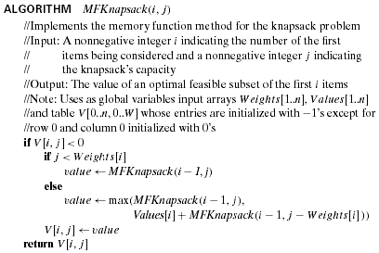
Memory Function for solving Knapsack Problem

Slide 44
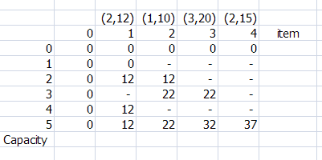
Memory Function for solving Knapsack Problem

Slide 45
Memory Function
In general, we cannot expect more than a constant-factor gain in using the memory function method for the knapsack problem because its time efficiency class is the same as that of the bottom-up algorithm
A memory function method may be less space-efficient than a space efficient version of a bottom-up algorithm.

Slide 46
Conclusion
Dynamic programming is a useful technique of solving certain kind of problems
When the solution can be recursively described in terms of partial solutions, we can store these partial solutions and re-use them as necessary

